Slide 1

Seconds from disaster
Unravelling the rms titanic collapse

Slide 2

Data description
Response: Survival
Categorical: Ticket Class, Port of Embarkation, Sex, SibSp, Parch
Continuous: Age, Fare

Slide 3
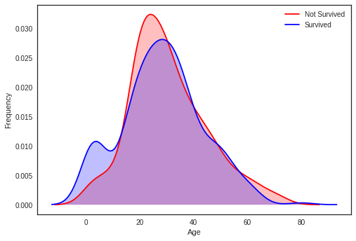
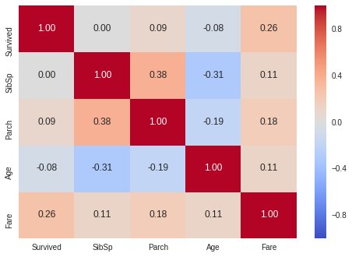
Exploratory-Data analysis
From the Correlation heat-map it is evident that fare has some effect on survival
Smoothed distribution plots of age based on two groups
Clearly we need to break down the data into different groups to get better insights

Slide 4
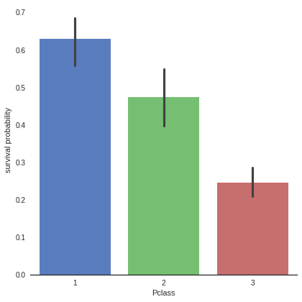
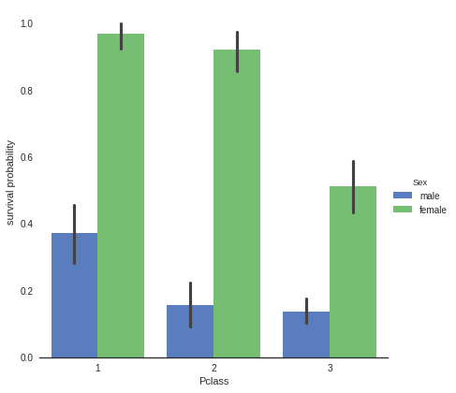
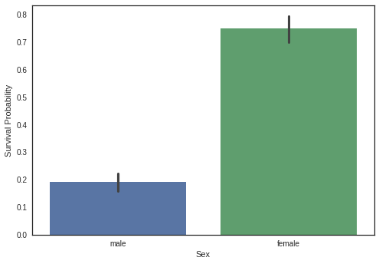
Exploratory-Data analysis
So female passengers had more chance of survival
Passengers from better class had better chance of survival
Moral of the story: If you are planning to take a cruise vacation make sure that you are a female and buy a ticket of first class

Slide 5
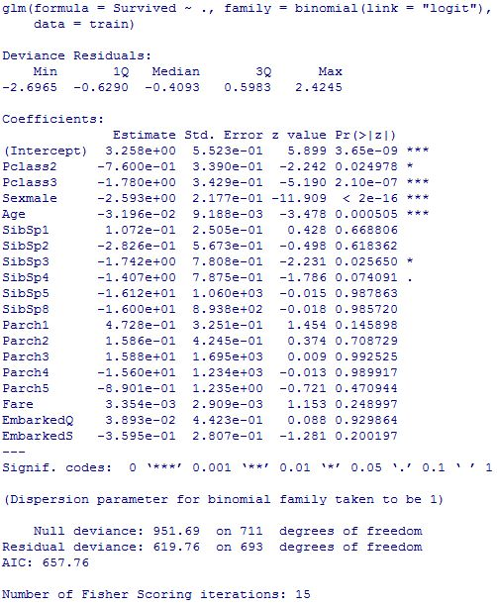
Basic logistic regression model
Missing Value Handling
Accuracy on Train Data ~ 81.32%
Accuracy on Test Data ~ 79.88%

Slide 6
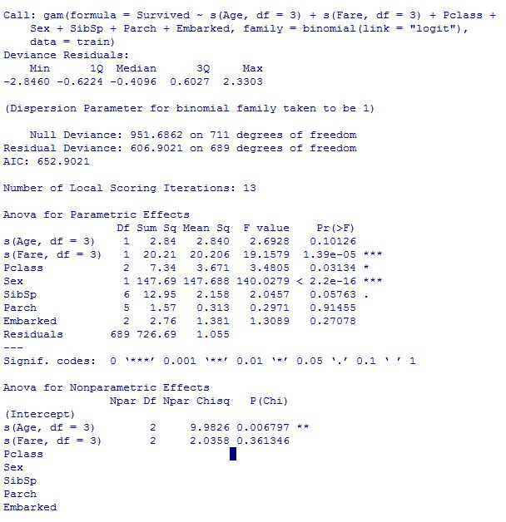
GAM Model
About the Model
Accuracy on Train Data ~ 81.32%
Accuracy on Test Data ~ 80.44%

Slide 7
SVM Classifier model:
What is SVM ?
Linear SVM test accuracy: 75.97%
Polynomial kernel SVM test accuracy: 69.23%
Gausian Kernel SVM test accuracy: 78.61%

Slide 8
Comparing the accuracies on test data:
GLM : 79.88%
GAM:80.44%
SVMs: <79%

Slide 9

Can We do better?

Slide 10
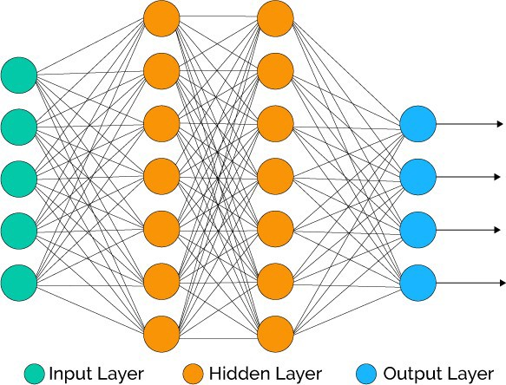
A neural network approach
What is a neural network?
Can we propel a network to get better accuracies?

Slide 11
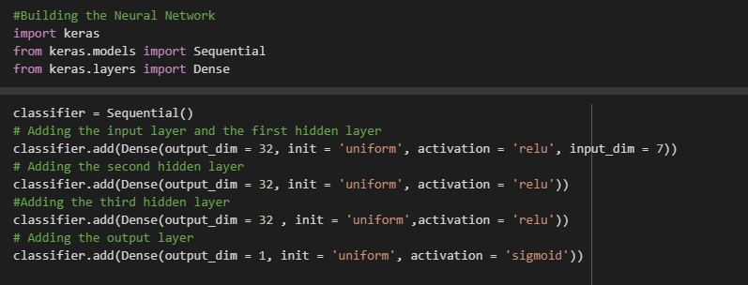
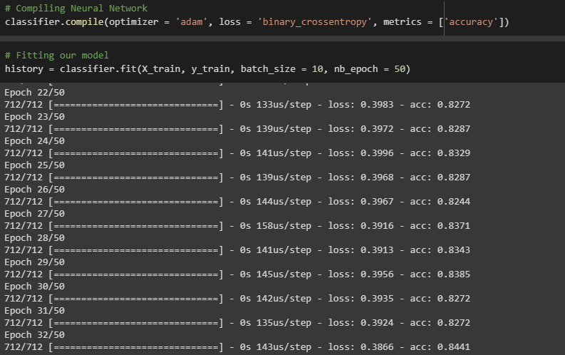
Code snippets:

Slide 12
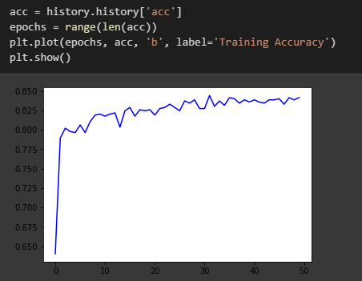
Training accuracy over epochs

Slide 13
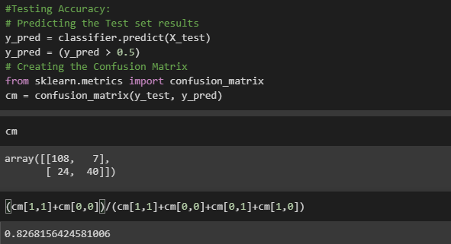
Test Accuracy
So yes we CAN do better!

Slide 14
Thank You!
Arnab Mukherjee
Debolina Paul
Sonakhya Samaddar
Meghna Bose

